Slide 1
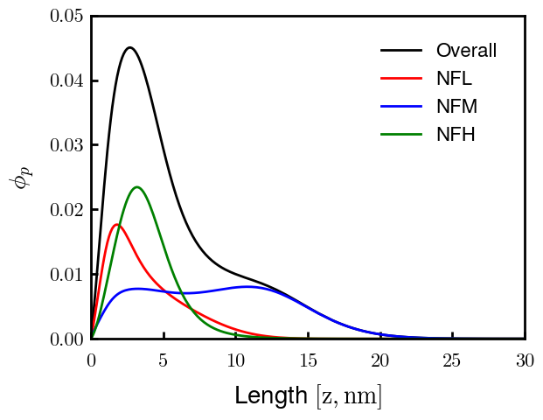
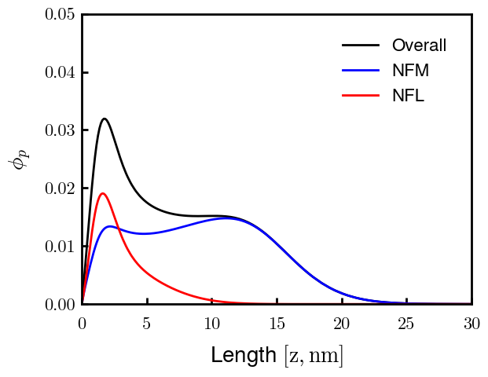
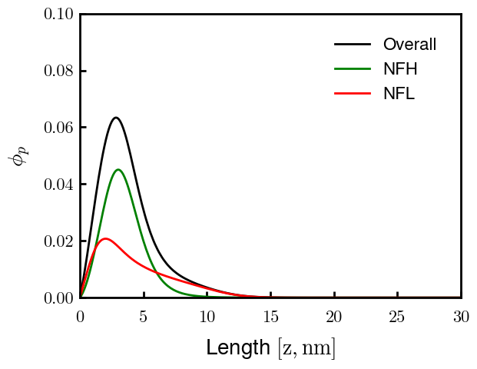
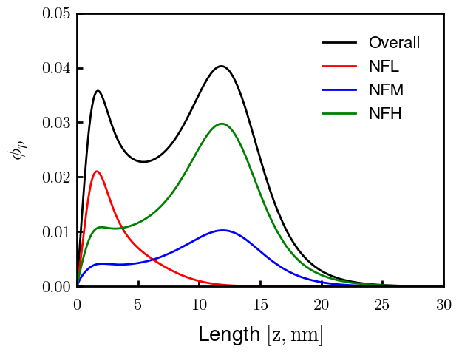
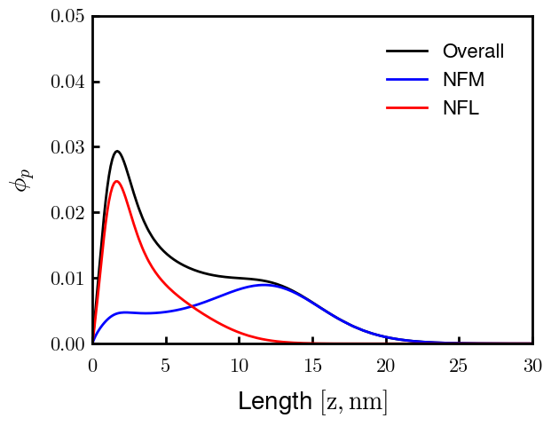
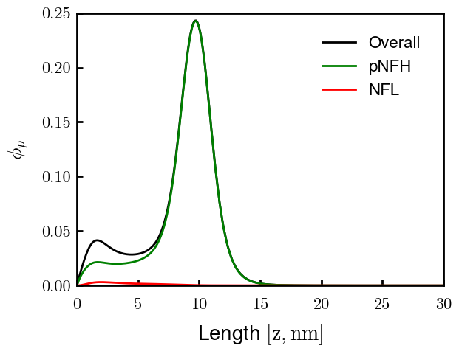
Cs = 150 mM (all)
7:3:2, non-phos
M—L (50:50)
H—L (25:75)
7:3:2, (all) phos
M—L (25:75)
pH—L (25:75)
Picked mixtures based on similarity to ternary brush morphology – speaks to the role of charge near the surface (here, from NFL)

Slide 2
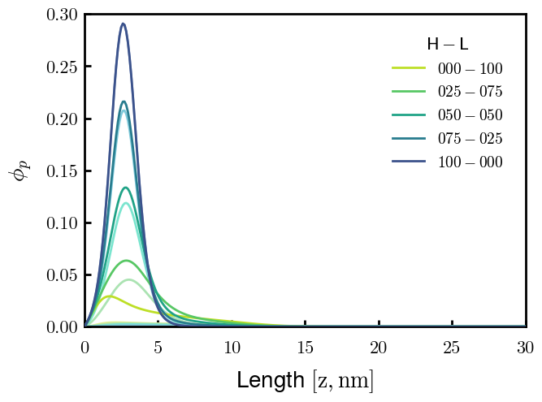
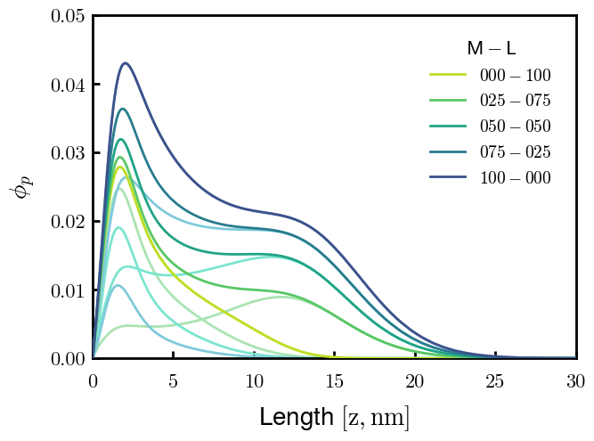
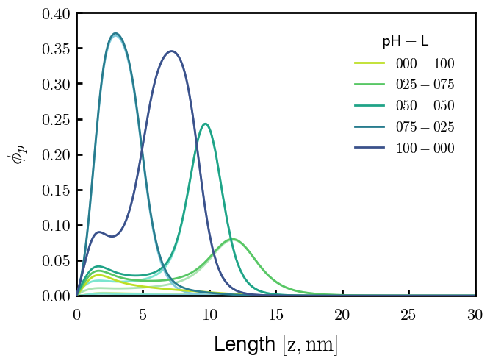
Cs = 150 mM (all)

Slide 3
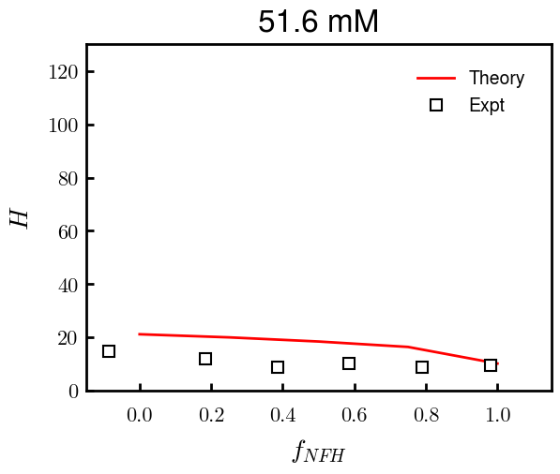
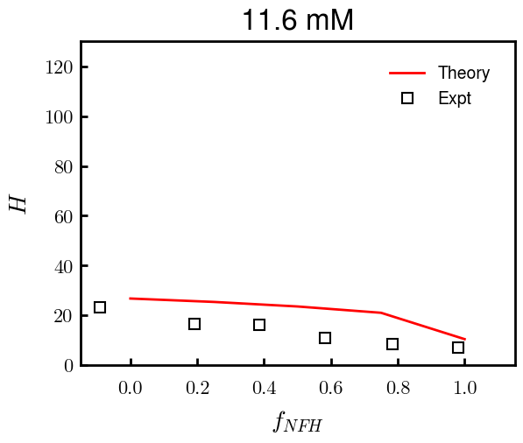
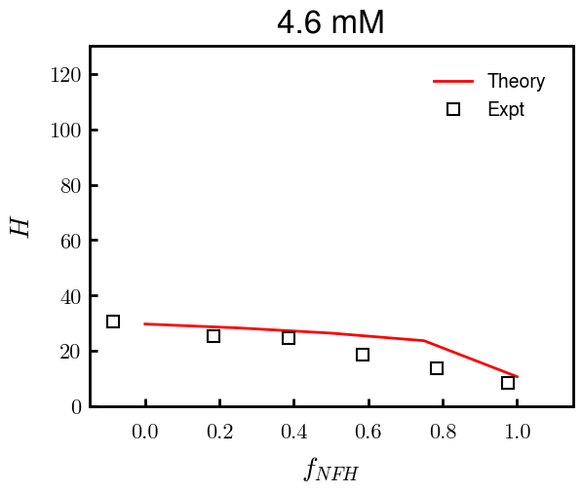
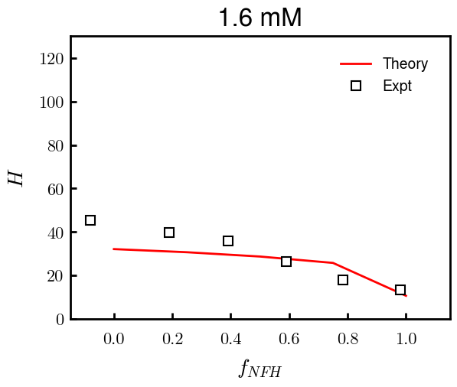
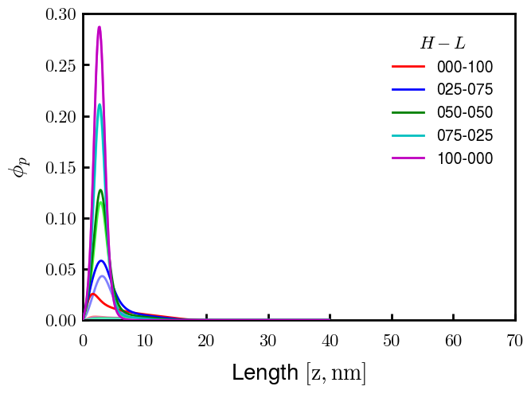
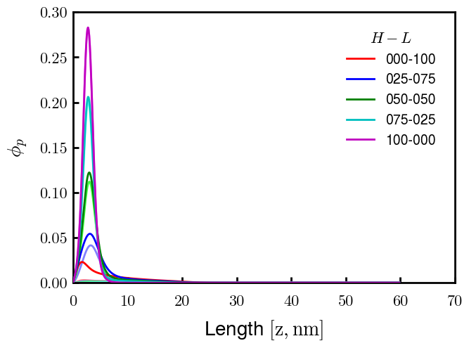
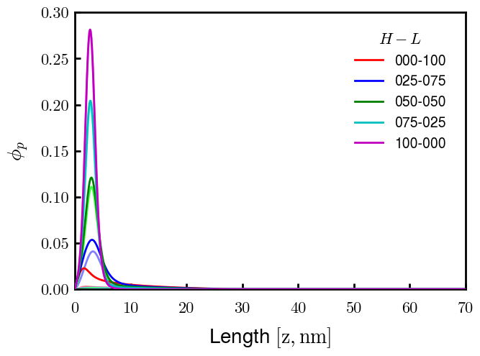

Binary NFH:NFL; sigma_total = 0.0344 c/nm2; bv = (0.6, 0.05)

Slide 4
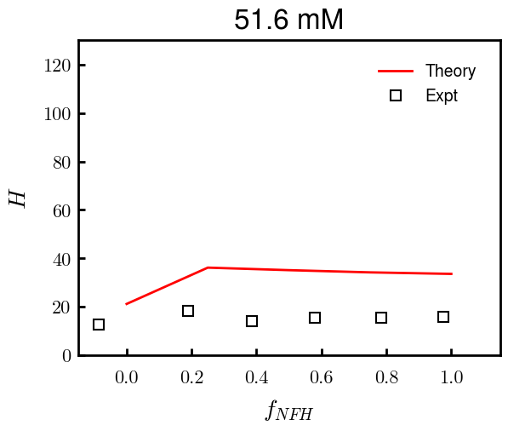
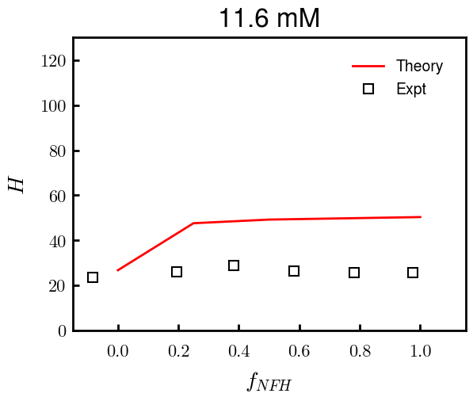
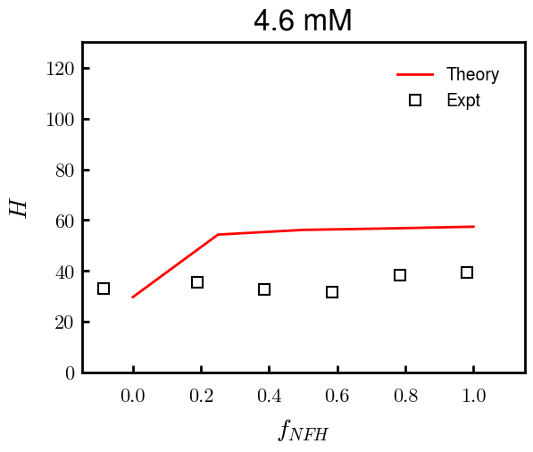
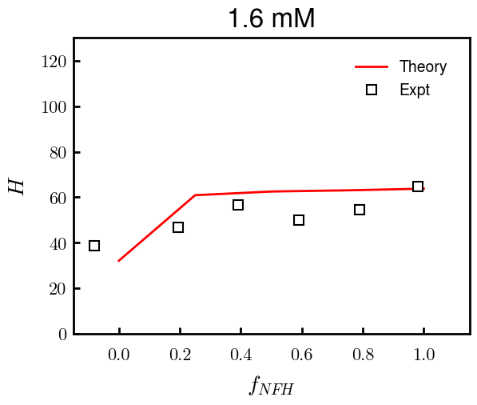
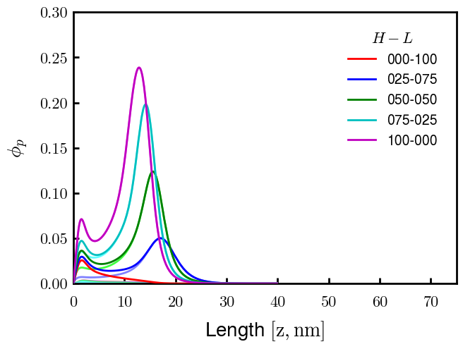
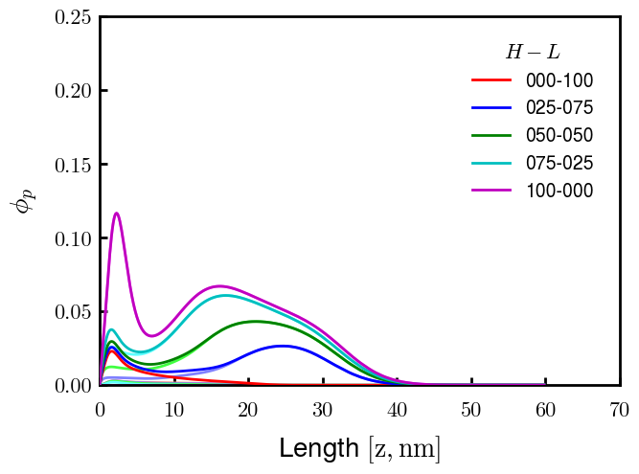
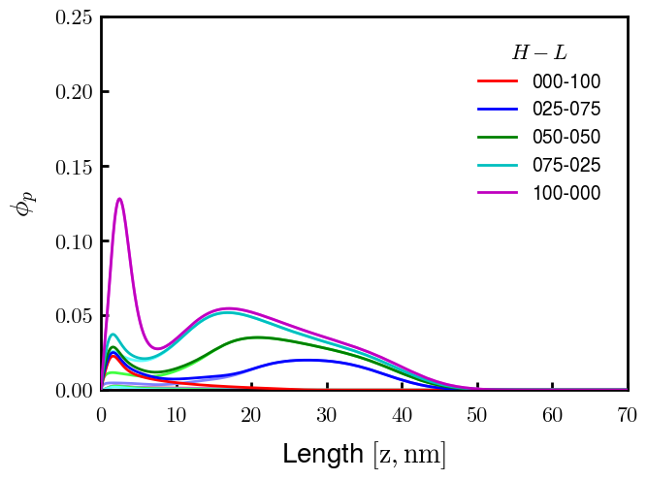
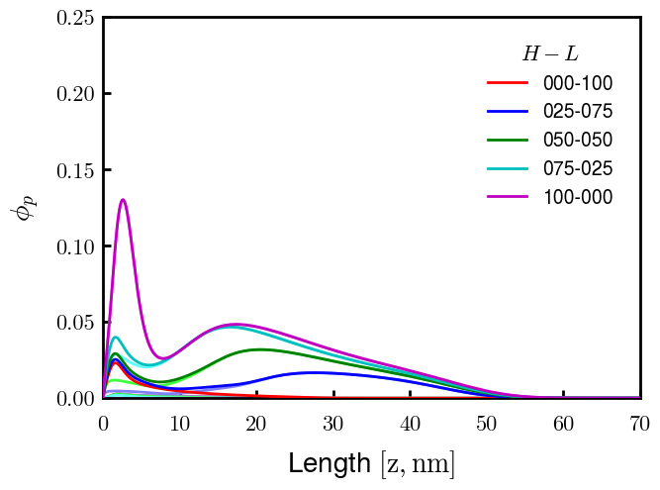
Binary pNFH:NFL; sigma_total = 0.0344 c/nm2; bv = [(0.6, 0.15), (0.6, 0.05)]

Slide 5
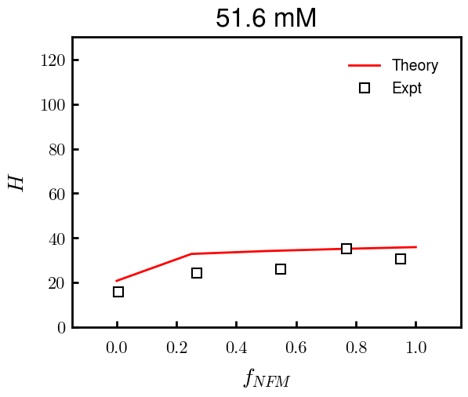
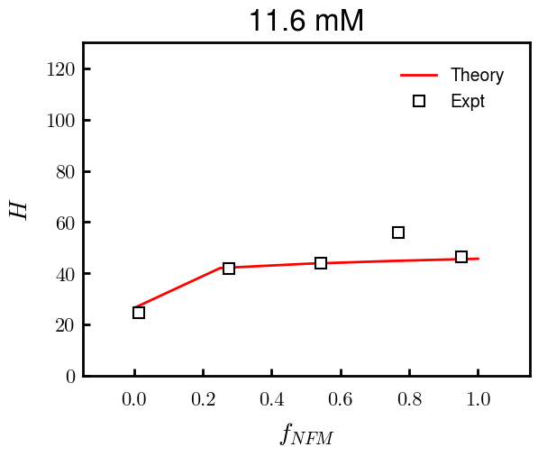
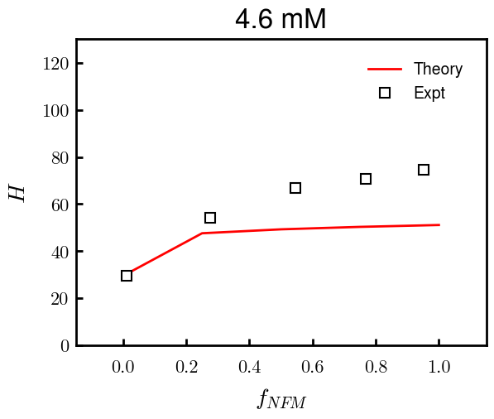
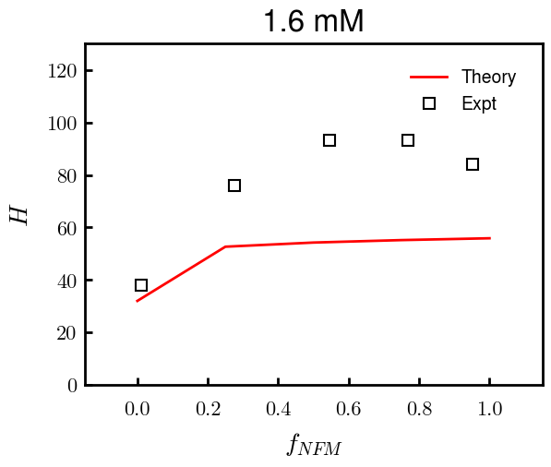
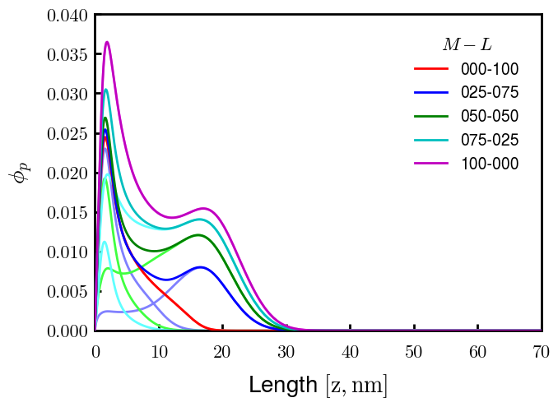
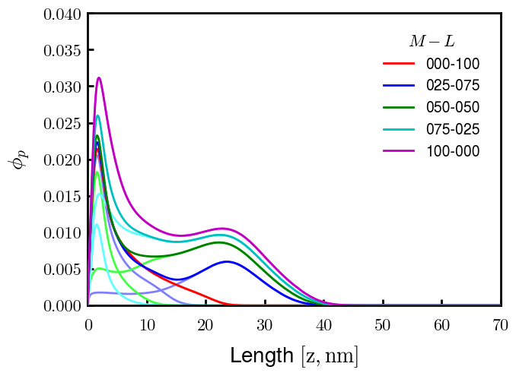
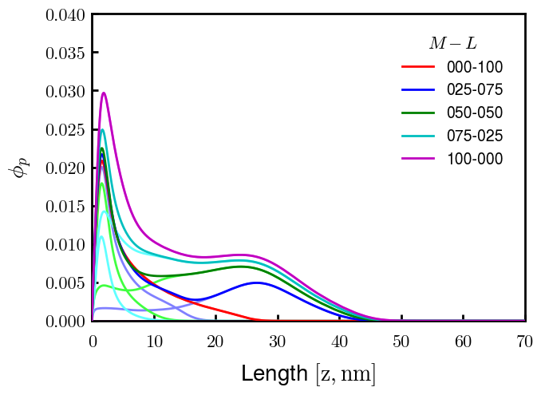
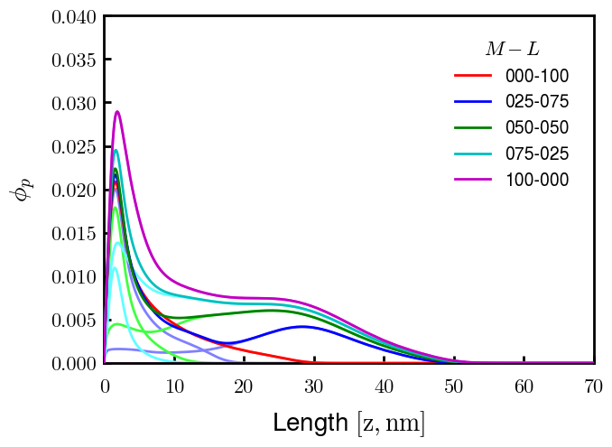
Binary NFM:NFL; sigma_total = 0.0315 c/nm2; bv = (0.6, 0.05)

Slide 6
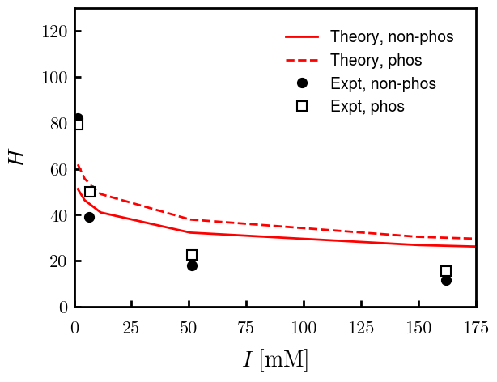
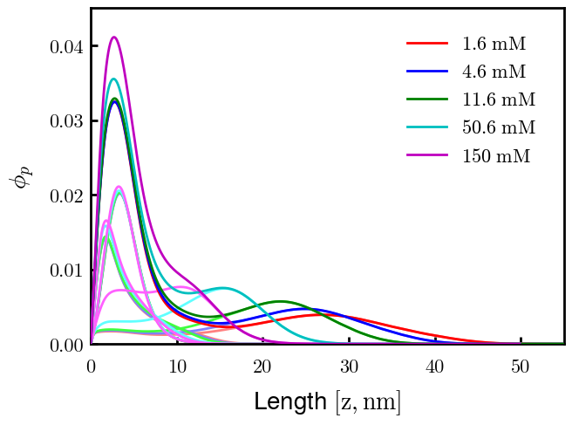
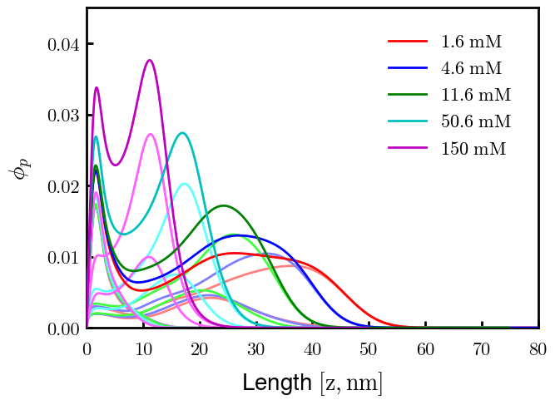
Non-phos
Phos

Slide 7
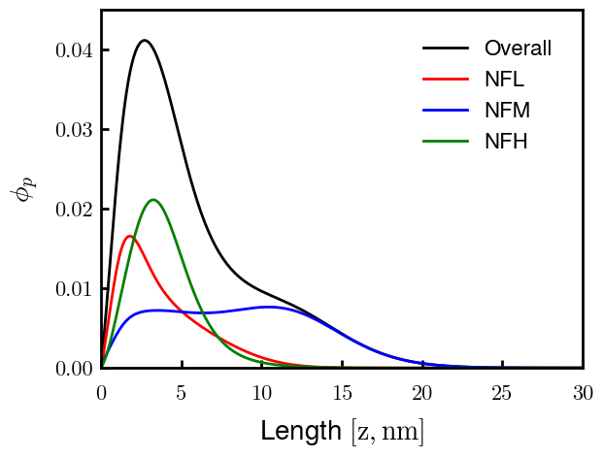
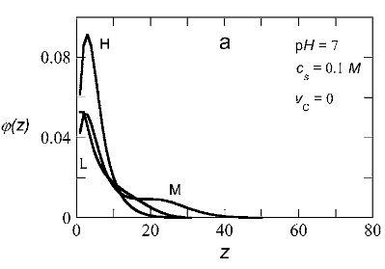
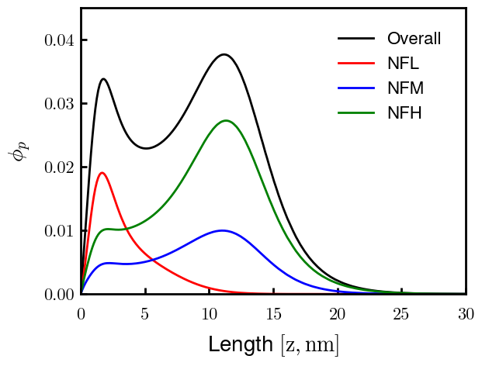
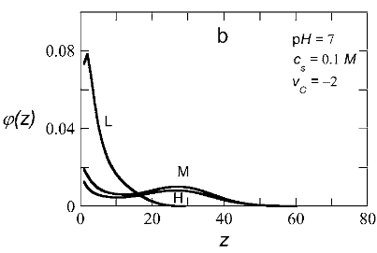
Non-phos, 0.150 M
Zhulina non-phos, 0.100 M
Phos, 0.150 M
Zhulina phos, 0.100 M

Slide 8
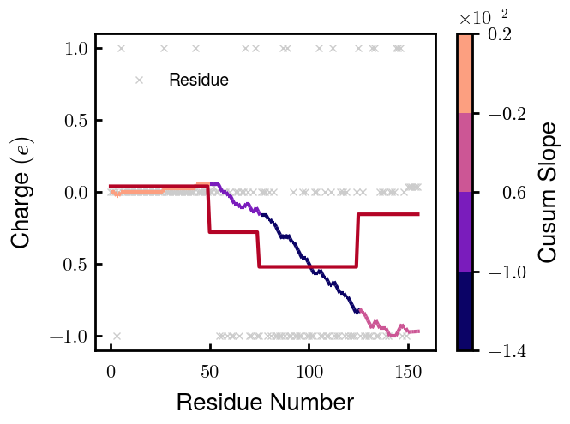
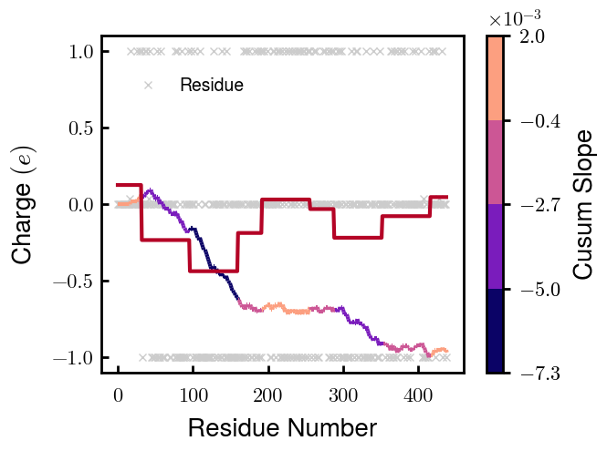

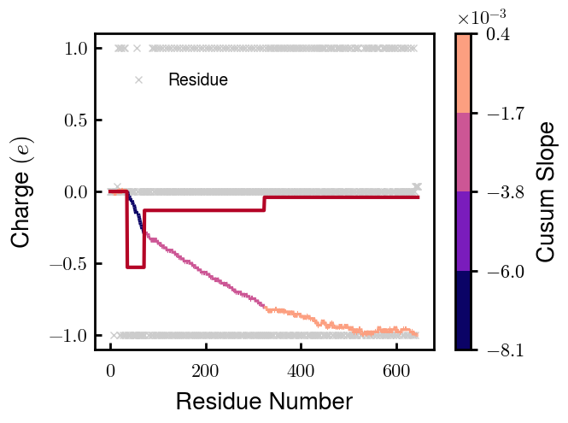
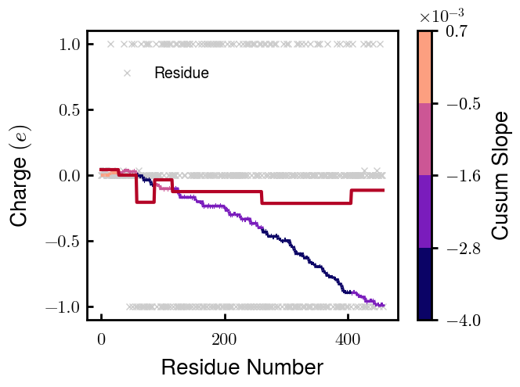
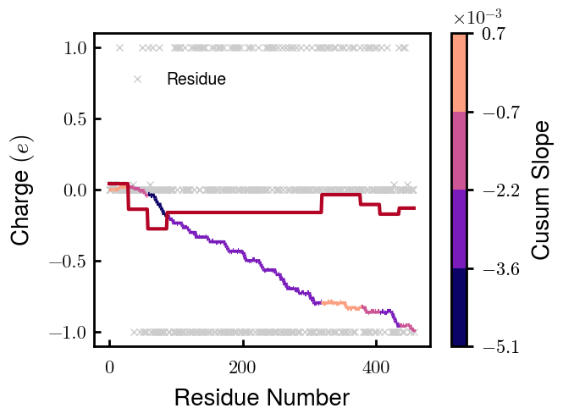
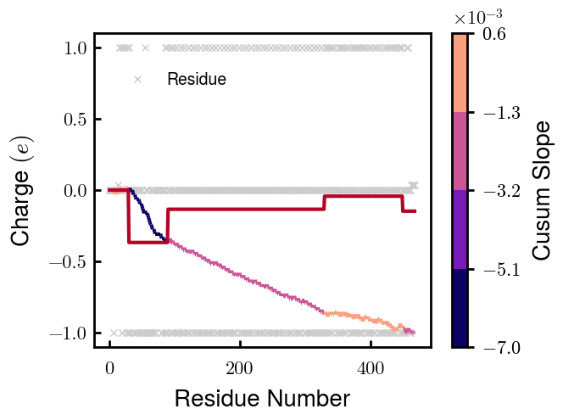
NFL
NFM
NFH
pNFH
NFM_S1
NFM_S2
pNFH_DE

Slide 9
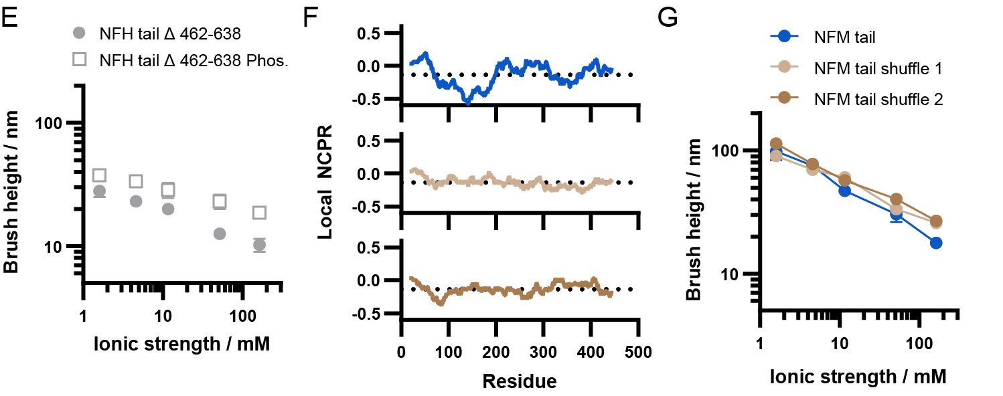
NFM_S1
NFM_S2

Slide 10
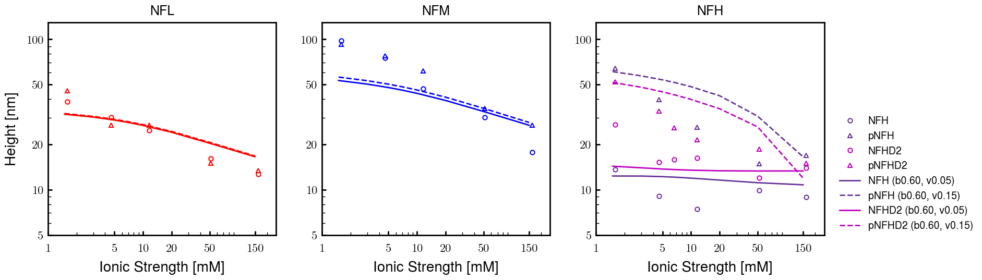
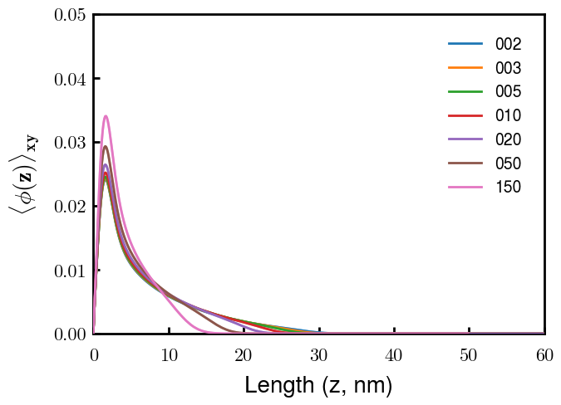
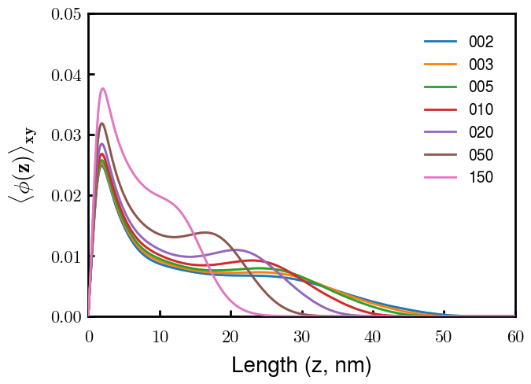
NFL
NFM
Next slide
Notes
pNFM running now; NFHb60v05c150 (cm225) running now
All non-phos same b,v
Phos L, M same as non-phos (few KsP)
Phos H 0.05 → 0.15 nm3
Potential improvements
Recheck pNFH(D2); no better option?
Recheck NFM; no better reasoning than b(s)?

Slide 11
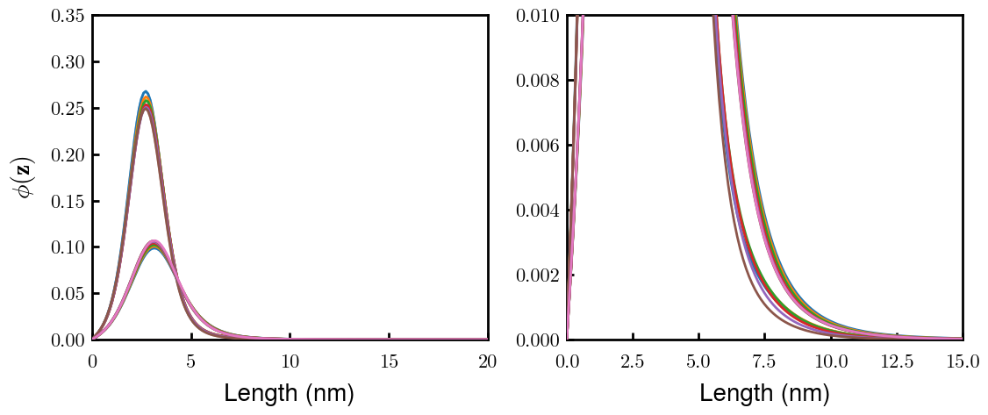



(p)NFH(D2)
NFH
NFHD2
pNFH
pNFHD2
(v = -1)
Points
v05 → v15 after phosphorylation
No condensed multilayer but worse fit

Slide 12



Chi (scaled)
Chi (BM 2023)
D: 3.65 (-1.00e);
E: 4.25 (-1.00e);
K: 10.53 (1.00e);
R: 12.48 (1.00e);
H: 6.00 (0.035e)
Biggest discrepancies between scaled and Zhulina: P (0.30 → 4.00), K (0.46 → 0.00), R (0.60 → 0.00)
(PKR has effect on pNFH; isolate P—currently seems too hydrophobic)

Slide 13









3
4
1
2
6
7
5
8
9

Slide 14



Other fits
pNFH P study next slide

Slide 15



Slide 16





pHb60v15_PKR
pHb60v15_P
pHb60v10_PKR
pHb60v10_P
PKR identified as amino acids with high discrepancies between expt and Zhulina bins
P isolated and good trend (change P to max, 2.25)
Even though better H, some conformational changes. Try to avoid by decreasing (in prog).
Single outer peak may not be bad— “flower” conf?
At the very least, increase high cs height and check NFHD2 (and eventually NFL, NFM)
Ensure effect does not ruin NFH(D2) (after screening)

Slide 17




Slide 18




Pr100

Slide 19





Slide 20


Try approaching surface

Slide 21



NFH (original); 31, 4
NFHD2; 40, 4
D2: delete 36-72
Rerun alg on D2
NFH (phos); 36, 4
NFHD2 (phos); 33, 4
Note: not currently doing this

Slide 22



Best fit w/ consistent chi_max
NFH
NFHD2
pNFH
(v = -1)
Points
v05 → v25 after phosphorylation
Bilayer (trilayer for 5?) pNFH morphology

Slide 23


Same params as prev. w/ diff thresh

Slide 24




Find best without multilayer
pNFH
pNFH
(v = -1)
(v = -1)
Multilayer at 20

Slide 25

Best pNFH scaling fit (no regard to realistic)
pNFH
(v = -1)
Points
v05 → v25 after phosphorylation
cm200 → cm250 after phospho
Multilayer
Phospho < native

Slide 26






Native NFH

Slide 27







NFHD2

Slide 28




pNFH(D2)
4e-03

Slide 29





1e-06
4e-03
norm
4e-03
Try to bring pNFH down → {cmXX + PXX} only choice
norm
4e-03

Slide 30




3e-04
3e-04
3e-04

Slide 31





Heights.params : b60v05 cm200
norm
1e-06
1e-05
1e-04
4e-03

Slide 32






Heights.params : b60v05 cm250
norm
ylog
norm
ylin
1e-06
1e-05
1e-04
5e-03

Slide 33




Heights.params: b60v10 cm{200, 225}
norm
1e-06
1e-05
1e-04
5e-03

Slide 34



Slide 35

 | Slope Bins 4 | Smear Count 25
Block number | Alpha w/ Henderson Hasselbalch | Chi Chi_max = 2.2
[0 50] | 0.040012 | 1.160000
[50 75] | -0.278451 | 0.720000
[75 125] | -0.519707 | 0.608000
[125 156] | -0.154453 | 0.529032

Slide 36

 | Slope Bins 4 | Smear Count 31
Block number | Alpha w/ Henderson Hasselbalch | Chi Chi_max = 2.2
[0 31] | 0.001103 | 0.922581
[31 62] | -0.386873 | 0.703226
[62 93] | -0.290146 | 0.967742
[93 496] | 0.037164 | 1.098759
[496 527] | -0.064533 | 0.819355
[527 620] | 0.010682 | 0.756989
[620 647] | -0.103326 | 0.696296

Slide 37






Previous
New

Slide 38





Slide 39


Response to stimuli given composition
Same data
Effect of composition given environment

Slide 40


NFL, pH 7.44, phos 1.5e (locs from LCMS)
Non-phos NFL
Block number | Alpha w/ Henderson Hasselbalch | Chi Chi_max = 3.2
[0 50] | 0.040012 | 1.540000
[50 75] | -0.278451 | 0.960000
[75 125] | -0.519707 | 0.868000
[125 156] | -0.154453 | 0.690323
 | Slope Bins 4 | Smear Count 25
Block number | Alpha w/ Henderson Hasselbalch | Chi Chi_max = 3.2
[0 50] | -0.019988 | 1.540000
[50 75] | -0.278451 | 0.960000
[75 125] | -0.519707 | 0.868000
[125 156] | -0.154453 | 0.690323

Slide 41

NFM, pH 7.44, phos 1.5e (locs from LCMS)
 | Slope Bins 4 | Smear Count 32
Block number | Alpha w/ Henderson Hasselbalch | Chi Chi_max = 3.0
[0 32] | 0.079143 | 1.275000
[32 64] | -0.186340 | 1.125000
[64 96] | -0.327964 | 1.181250
[96 160] | -0.460694 | 0.787500
[160 224] | -0.124999 | 1.115625
[224 288] | -0.023510 | 0.956250
[288 352] | -0.242085 | 1.003125
[352 384] | -0.031302 | 1.125000
[384 416] | -0.123860 | 1.050000
[416 438] | 0.046945 | 1.281818

Slide 42





Bin 3 NFM, pH 7.44, phos 1.5e (locs from LCMS)

Slide 43




Bin 5 NFM, pH 7.44, phos 1.5e (locs from LCMS)

Slide 44



Phos 2 NFM, pH 7.44, phos 2.0e (locs from LCMS)

Slide 45



Chi 2.5 NFM, pH 7.44, phos 2.0e (locs from LCMS)

Slide 46



NFM, pH 7.44, non-phos

Slide 47


NFH, pH 7.44, phos 1.5e (locs from LCMS)
 | Slope Bins 4 | Smear Count 36
Block number | Alpha w/ Henderson Hasselbalch | Chi Chi_max = 3.2 | Chi Chi_max = 3.0
[0 36] | 0.000945 | 1.266667 | 1.20000
[36 72] | -0.527455 | 0.900000 | 0.85000
[72 324] | -0.208376 | 1.729365 | 1.628571
[324 396] | -0.111195 | 1.416667 | 1.333333
[396 432] | -0.152824 | 1.344444 | 1.266667
[432 647] | -0.033955 | 1.077209 | 1.015814

Slide 48




Phos block dashed
Phos block dashed

Slide 49



Best are b3.0 v2.0 and b3.0 v3.0, but max H not high enough
Possible solutions:
Lower chi_max
Change aa_disc to have more charge
Force spectra?
Better for low salt, but high salt will melt brushes together

Slide 50



M1
pMx5

Slide 51



b3.00; v1, 2
b4.00; v2, 2.5, 3, 5, 10
b5.00; v3, 10, 15, 40
53 Nk
39 Nk
32 Nk

Slide 52
Binary results

Slide 53



Matrix Approach
Updated 04/04/2023

Slide 54














H Vol decrease (by v)
H Vol decrease (by b)
Desired “linearity” by tuning /thresh/ based on polymer density of expelled NFL
L Vol decrease (by b)
Comes at severe cost of overall height. Have to minimize outer concentration to approach pure thresh of 1e-06

Slide 55














H Vol decrease (by v)
H Vol decrease (by b)
Chimax 3.5
Desired “linearity” by tuning /thresh/ based on polymer density of expelled NFL
L Vol decrease (by b)
Comes at severe cost of overall height. Have to minimize outer concentration to approach pure thresh of 1e-06

Slide 56








F (3.5)
Chimax 3.5
Chimax 3.0
Scaled by 1.5
Scaled by 1.6
Scaled by 1.6
Scaled by 1.5
Scaled by 1.5
Scaled by 1.5
Scaled by 1.8
Scaled by 1.8

Slide 57
















Last test: same stiffness factor (b^3/v0) but with varying total volume

Slide 58












H Vol decrease (by v)
H Vol decrease (by b)
a2C_30
a2D_30
a2E_30
Rerun for Cs
b1C_30
b1D_30
b1E_30
L Vol decrease (by b)
a1C_30
a1D_30
a1E_30
g1C_30
g1D_30
g1E_30
Rerun for Cs

Slide 59












H Vol decrease (by v)
H Vol decrease (by b)
a2C
a2D
a2E
b1C
b1D
b1E
Block 4 (NFL end)
L Vol decrease (by b)
a1C
a1D
a1E
g1C
g1D
g1E

Slide 60









H Vol decrease (by v)
Chimax 3.5
H Vol decrease (by b)
a2C_30
a2D_30
a2E_30
b1C_30
b1D_30
b1E_30
L Vol decrease (by b)
a1C_30
a1D_30
a1E_30
g1C_30
g1D_30
g1E_30

Slide 61







For i as L and H:
Pure height profiles
Mixed height profiles
Current L library
Current H library
Skip; marginal increase in vol prob not enough
Move onto chi3.0; larger NFL vol library

Slide 62





NFL
All plotting wrong L pure; look only at purp
NFH
H volume too low to neutralize L (v = 31 nm3/c)

Slide 63







H volume v = 60 nm3/c

Slide 64







H volume too low to neutralize L

Slide 65










NFH, V = 70
L30

Slide 66





NFH & NFL v = 0.15
a2D
b1D
g1D

Slide 67





Based on NFH b5v15c3, apply VL = VH
NFL and NFH are from same amino acids but diff chain lengths. Should VL = VH?
L30 / H70
L80 / H20
L30 / H70
L80 / H20

Slide 68






L30 / H70
L80 / H20
L30 / H70
L80 / H20

Slide 69
L Fitting

Slide 70


VL = VH

Slide 71







Try b change, v same as H (0.15)
Phi unrealistic (?)
Phi unrealistic
Phi very unrealistic
Phi very unrealistic

Slide 72






Try similar params to H
5.6
11.2
16.8
28
56
7.5
11.25
18.75

Slide 73







Try similar params to H, b0.36
7.8
15.6
23.4
31.2
Unrealistic vol
Not very sensitive to v; not high enough to intersect neighboring chains (function of b and sigma)

Slide 74


Continuation from prev params

Slide 75







v2.7 and some fine
b1.50 v2.7 c3.2
b1.75 v2.7 c3.2
b1.75 v2.5 c3.2
b1.75 v2.5 c3.0
b2.0 v2.7 c3.2
b2.25 v2.7 c3.2
b2.50 v2.7 c3.2
Phi too small to decrease v0

Slide 76










b2.0 v10.0 c3.0
b2.0 v8.0 c3.0
b2.0 v6.0 c3.0
b2.0 v4.0 c3.0
b2.0 v2.0 c3.0
Phi limit
b1.8 v10.0 c3.0
b1.8 v8.0 c3.0
b1.8 v6.0 c3.0
b1.8 v3.0 c3.0
b1.8 v2.0 c3.0
Phi limit

Slide 77





b1.6 v10.0 c3.0
b1.6 v8.0 c3.0
b1.6 v6.0 c3.0
b1.6 v2.0 c3.0
b1.6 v1.5 c3.0
Phi limit

Slide 78









b2.0 v2.7 c3.2
b3.0 v3.5 c3.5
b3.0 v7.0 c3.5
b3.0 v7.0 c3.0
Phi too small
Phi too small to decrease v0
b4.0 v12.0 c3.0
b5.0 v20.0 c3.0
b5.0 v20.0 c4.0
b5.0 v5.0 c3.0
b5.0 v10.0 c3.0
Phi too small to decrease v0

Slide 79





v20
b5.0 v20.0 c3.0
b4.5 v20.0 c3.0
b4.0 v20.0 c3.0
b3.5 v20.0 c3.0
v10
b5.0 v10.0 c3.0
b4.0 v10.0 c3.0
b3.0 v10.0 c3.0
b2.0 v10.0 c3.0

Slide 80




b2.00 v2.70 c3.20
b2.00 v2.75 c3.20

Slide 81
NFH fitting (from NFL best fit)

Slide 82








b1.00, v0.50, c3.2
b2.00, v4.00, c3.2, th2.5e-02
b1.00, v2.00, c3.2
b1.00, v1.00, c3.2

Slide 83
Mixture

Slide 84



Slide 85


b = 0.75

Slide 86





Slide 87
b = 1.0

Slide 88





Slide 89
b = 1.25

Slide 90




Chi 2.6
Bad vol frac

Slide 91








b25v0
b25v1
b25v2
b25v3

Slide 92




Chi 2.8
Bad vol frac

Slide 93





Slide 94
b = 1.50

Slide 95






Chi 2.8
Bad vol frac

Slide 96





Slide 97

b = 2.00
v4 = 0.25*b^3

Slide 98


Bad vol frac

Slide 99



Slide 100
Fine tune

Slide 101



b1.25, v1.95, c3.0
b1.50, v3.38, c3.0
b2.00, v4.00, c3.0
Norm seems to capture kinked behavior

Slide 102




Slide 103



b1.25, v1.95, c3.2
b1.50, v3.38, c3.2
b2.00, v4.00, c3.2

Slide 104




Slide 105


b1.25
b1.50
b2.00
c2.8
c3.0
c3.2

